Slide 1
CS112 : Introduction to Python Programming
Week 13: lab practice

Slide 2
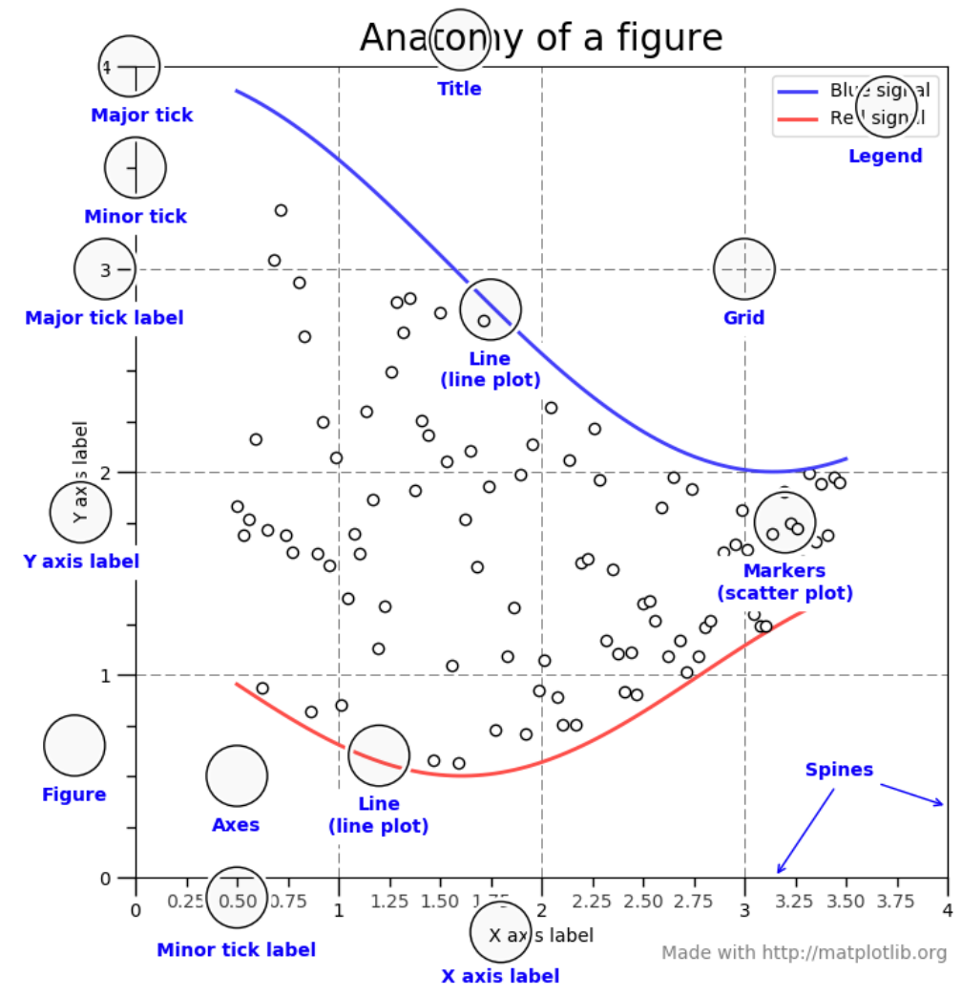
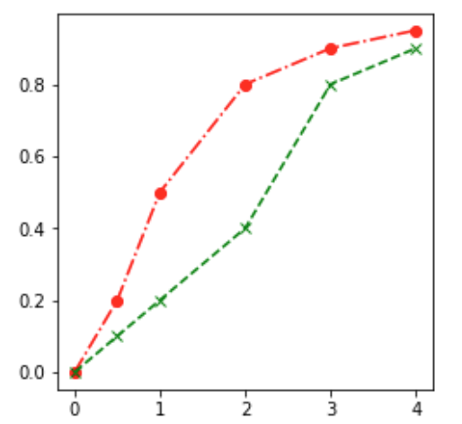
Practice1
1. Make line plots as in the example. Try changing every parameter of a Figure object, such as title, xlabel, ylabel, x ticks, y ticks, legend, plot color, style, …
drug_conc = [0,0.5,1,2,3,4]
response1 = [0,0.2,0.5,0.8,0.9,0.95]
response2 = [0,0.1,0.2,0.4,0.8,0.9]

Slide 3
Practice1
2. Save the figure in different formats, dpi and other parameters

Slide 4
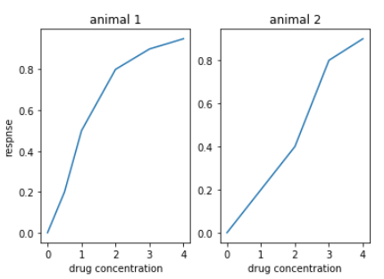
Practice2
Make multiple line plots in one figure. One subplot for one animal
drug_conc = [0,0.5,1,2,3,4]
Animal1:
response1 = [0,0.2,0.5,0.8,0.9,0.95]
Animal2:
response2 = [0,0.1,0.2,0.4,0.8,0.9]

Slide 5
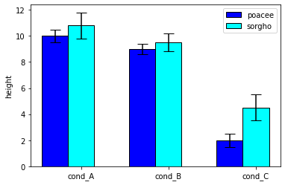
Practice3
Visualize the heights of two plants poacee and sorgho using barplot, the measurements have been given as below:
# poacee height and std errors
bars1 = [10, 9, 2]
err1 = [0.5, 0.4, 0.5]
# sorgho height and std errors
bars2 = [10.8, 9.5, 4.5]
err2 = [1, 0.7, 1]

Slide 6
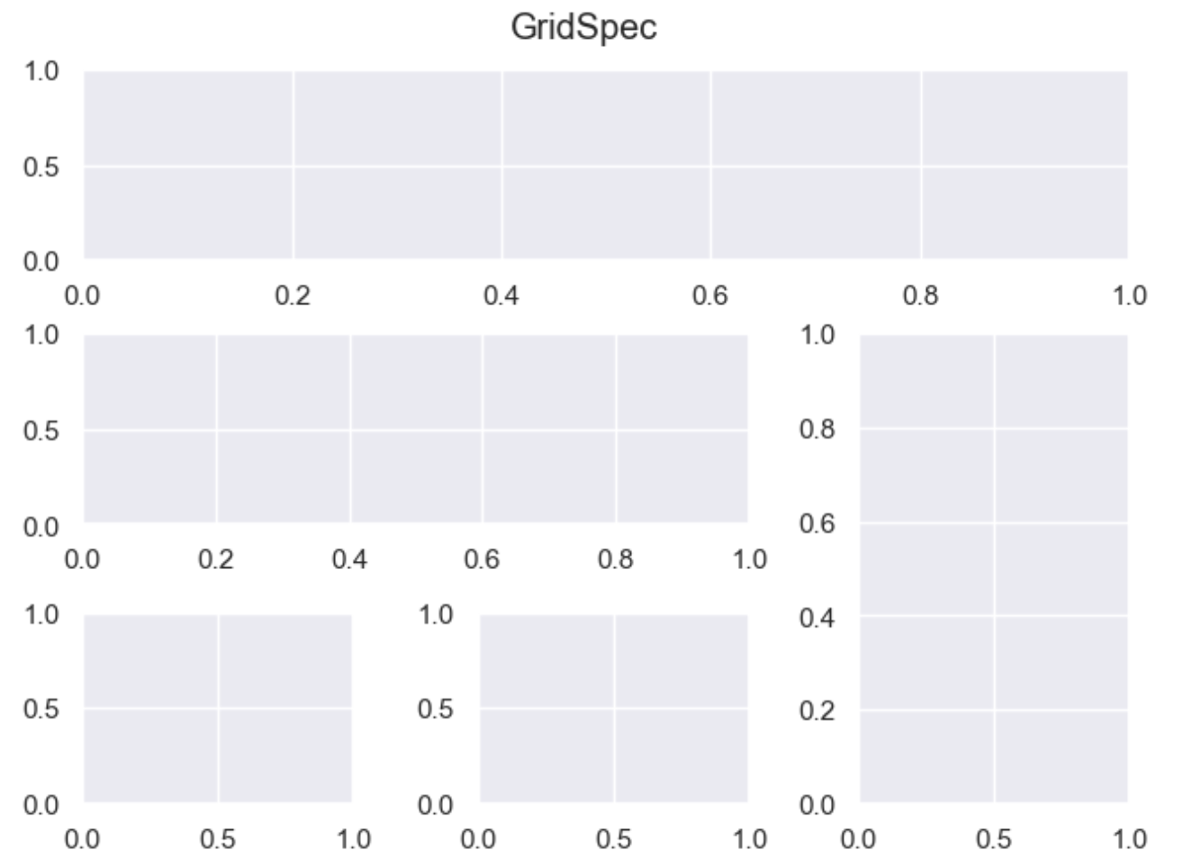
Practice4
Create subplots with the following layout using GridSpec

